Slide 1
Theory of Computation
Lecture 9
CFG & PDA
Dr. Samar Hesham
Department of Computer Science
Faculty of Computers and AI
Cairo University
Egypt

Slide 2
Syllabus and Terminologies
Regular Languages .. Regular Sets
REs (Regular Expressions)
FSMs (or FSA/FA) … Finite State Machines/Automata
DFSM/DFA vs. NDFSM/NFA … Deterministic vs. Non-deterministic FSM
Comparison and conversion
Examples & Closure Operations
Context Free Languages
CFGs … Context Free Grammars
PDA … Push Down Automata
Some applications
Turing Machine

Slide 3
Derivation
We derive strings in the language of a CFG by starting with the start symbol, and repeatedly replacing some variable A by the right side of one of its productions.
Example:
S → aSb
S → ab
Same grammar using (or ‘|’)
S → aSb | ab

Slide 4
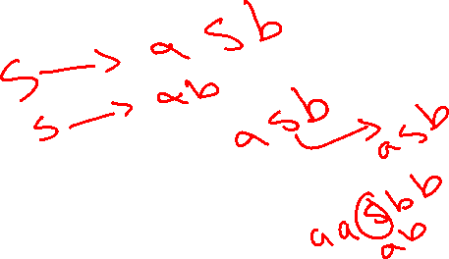
Derivation
CFG:
S → aSb
S → ab
Derivation example for “aabb”
Using S → aSb
➔generates uncompleted string that still has a non- terminal S.
Then using S → ab to replace the inner S
Generates “aabb”
S ➔ aSb ➔ aabb ……[Successful derivation of aabb]

Slide 5
Context-Free Languages
Definition. Given a context-free grammar
G = (∑, NT, R, S), the language generated or
derived from G is the set:
L(G) = {w : }
S ⇒* w
Definition. A language L is context-free if there is a context-free grammar G = (∑, NT, R, S), such that L is generated from G

Slide 6
CFGs & CFLs: Example 1
{a^{n} b^{n} | n≥0}
One of our canonical non-RLs.
S → ε | a S b
Formally:
G = ({S}, {a,b}, {S → ε, S → a S b}, S)

Slide 7
CFG -1 : Balanced-parentheses
Prod1: S → (S)
Prod2: S → ()
Derive the string ((()))
S → (S) …..[by prod1]
→ ((S)) …..[by prod1]
→ ((())) …..[by prod2]

Slide 8
CFG -2 : Palindrome
Describe palindrome of a’s and b’s using CFG
1] S → aSa 2] S → bSb
3] S → Λ
Derive “baab” from the above grammar.
S → bSb [by 2]
→ baSab [by 1]
→ ba ab [by 3]

Slide 9
CFG -3 : Even-Palindrome
i.e. {Λ, ab, abbaabba,… }
S → aSa| bSb| Λ Derive abaaba
S
a
S
a
b
S
b
a
S
a
Λ
Can you modify this grammar to accept odd-length palindromes?

Slide 10
CFG – 4
Describe anything (a+b)* using CGF
1] S → Λ 2] S → Y 3] Y→ aY
4] Y → bY 5] Y →a 6] Y→ b
Derive “aab” from the above grammar.
S → Y [by 1]
Y → aY [by 3]
Y → aaY [by 3]
Y → aab [by 6]

Slide 11
CFGs & CFLs: Example 3
{a^{m} b^{n} c^{m+n} | m,n≥0}
?
?
Rewrite as {a^{m} b^{n} c^{n} c^{m} | m,n≥0}:
S → S’ | a S c
S’ → ε | b S’ c

Slide 12
CFGs & CFLs: Non-Example
{a^{n} b^{n} c^{n} | n≥0}
Can’t be done!
Intuition: Can count to n, then can count down from n, but forgetting n after that.
i.e., a stack as a counter.

Slide 13
Parse Tree
A parse tree of a derivation is a tree in which:
Each internal node is labeled with a nonterminal
If a rule A → A₁A₂…A_{n} occurs in the derivation then A is a parent node of nodes labeled A₁, A₂, …, A_{n}
S
a
S
a
S
b
S
e

Slide 14
Parse Trees
S → A | A B
A → ε | a | A b | A A
B → b | b c | B c | b B
Sample derivations:
S ⇒ AB ⇒ AAB ⇒ aAB ⇒ aaB ⇒ aabB ⇒ aabb
S ⇒ AB ⇒ AbB ⇒ Abb ⇒ AAbb ⇒ Aabb ⇒ aabb
These two derivations use same productions, but in different orders.
This ordering difference is often uninteresting.
Derivation trees give way to abstract away ordering differences.
S
Root label = start node.
A
B
Each interior label = variable.
A
A
b
B
Each parent/child relation = derivation step.
Each leaf label = terminal or ε.
a
a
b
All leaf labels together = derived string = yield.

Slide 15
Leftmost vs. Rightmost Derivations
Definition. A left-most derivation of a sentential form is one in which rules transforming the left-most nonterminal are always applied
Definition. A right-most derivation of a sentential form is one in which rules transforming the right-most nonterminal are always applied

Slide 16
Leftmost vs. Rightmost Derivations
S → A | A B
A → ε | a | A b | A A
B → b | b c | B c | b B
Sample derivations:
S ⇒ AB ⇒ AAB ⇒ aAB ⇒ aaB ⇒ aabB ⇒ aabb
S ⇒ AB ⇒ AbB ⇒ Abb ⇒ AAbb ⇒ Aabb ⇒ aabb
These two derivations are special:
1st derivation is leftmost.
Always picks leftmost variable to expand.
2nd derivation is rightmost.
Always picks rightmost variable to expand.
S
A
B
A
A
b
B
a
a
b

Slide 17
Derivation Order
Leftmost derivation:
Rightmost derivation:

Slide 18
Leftmost derivation:
Rightmost derivation:

Slide 19
Derivation Trees Example

Slide 24
Derivation Tree

Slide 25
Derivation Tree
yield

Slide 26
Partial Derivation Trees
Partial derivation tree

Slide 27
Partial derivation tree

Slide 28
sentential
form
Partial derivation tree
yield

Slide 29
Sometimes, derivation order doesn’t matter
Leftmost:
Rightmost:
Same derivation tree

Slide 30
Different Derivation Trees?
S → A | A B
A → ε | a | A b | A A
B → b | b c | B c | b B
Other derivation trees for this string?
w = aabb
?
S
?
S
S
A
A
B
A
B
A
A
Infinitely many others possible.
A
A
b
B
A
A
b
A
A
A
b
a
a
b
a
A
b
a
ε
A
b
a
a

Slide 31
Ambiguity

Slide 32
Ambiguous Grammar
Definition. A grammar G is ambiguous if there is a word w ∈ L(G) having at least two different parse trees
S → A
S → B
S → AB
A → aA
B → bB
A → e
B → e
Notice that this grammar has at least two left-most derivations

Slide 33
leftmost derivation

Slide 34
leftmost derivation

Slide 35
Two derivation trees

Slide 36
The grammar
is ambiguous:
string
has two derivation trees

Slide 37
The grammar
is ambiguous:
string
has two leftmost derivations

Slide 38
Definition:
A context-free grammar is ambiguous
if some string has:
two or more derivation trees

Slide 39
In other words:
A context-free grammar is ambiguous
if some string has:
two or more leftmost (or rightmost) derivations

Slide 40
Why do we care about ambiguity?
take

Slide 43
Correct result:

Slide 44
Ambiguity
CFG ambiguous ⇔ any of the following equivalent statements:
∃ string w with multiple derivation trees.
∃ string w with multiple leftmost derivations.
∃ string w with multiple rightmost derivations.
Defining ambiguity of grammar, not language.

Slide 45
Ambiguity & Disambiguation
Given an ambiguous grammar, would like an equivalent unambiguous grammar.
Allows you to know more about structure of a given derivation.
Simplifies inductive proofs on derivations.
Can lead to more efficient parsing algorithms.
In programming languages, want to impose a canonical structure on derivations. E.g., for 1+2×3.
Strategy: Force an ordering on all derivations.

Slide 46
Disambiguation: Example 1
Exp → n
| Exp + Exp
| Exp × Exp
What is the equivalent unambiguous grammar?
Exp → Term
| Term + Exp
Term → n
| n × Term
Uses
operator precedence
left-associativity

Slide 47
We fix the ambiguous grammar:
New non-ambiguous grammar:

Slide 49
Unique derivation tree

Slide 50
The grammar :
is non-ambiguous:
Every string has a unique derivation tree

Slide 51
Inherent Ambiguity
Some context free languages are inherently ambiguous
have only ambiguous grammars
Example:

Slide 52
The string
has two derivation trees

Slide 53
Disambiguation
What is a general algorithm?
?
?
None exists!
There are CFLs that are inherently ambiguous
Every CFG for this language is ambiguous.
E.g., {a^{n}b^{n}c^{m}d^{m} | n≥1, m≥1} ∪ {a^{n}b^{m}c^{m}d^{n} | n≥1, m≥1}.
So, it is not necessarily eliminate ambiguity!

Slide 54
CFG Simplification
Can’t always eliminate ambiguity.
But, CFG simplification & restriction still useful theoretically & pragmatically.
Simpler grammars are easier to understand.
Simpler grammars can lead to faster parsing.
Restricted forms useful for some parsing algorithms.
Restricted forms can give you more knowledge about derivations.

Slide 55


CFG Simplification: Example
How can the following Grammar be simplified?
S → A B
S → A C D
A → A a
A → a
A → a A
A → a
C → ε
D → d D
D → E
E → e A e
F → f f
1) Delete: B useless because nothing derivable from B.
2) Delete either A→Aa or A→aA.
3) Delete one of the idential productions.
4) Delete & also replace S→ACD with S→AD.
5) Replace with D→eAe.
6) Delete: E useless after change #5.
7) Delete: F useless because it is not derivable from S.

Slide 56

CFG Simplification
Eliminate ambiguity.
Eliminate “useless” variables.
Eliminate ε-productions: A→ε.
Eliminate unit productions: A→B.
Eliminate redundant productions.
Trade left- & right-recursion.

Slide 57





Trading Left- & Right-Recursion
Left recursion: A → A α
Right recursion: A → α A
Most parsing algorithms have trouble with one,
In recursive descent, avoid left recursion.

Slide 58
CFG & PDA

Slide 59
Hierarchy of languages
Non-Recursively Enumerable Languages
Recursively Enumerable Languages
PDA
Recursive Languages
Context-Free Languages
Regular Languages
FSA

Slide 60
Pushdown Automaton -- PDA
tape
tape head
stack head
finite
control
stack

Slide 61
Pushdown Automaton -- PDA
Input String
Stack
States

Slide 62
Pushdown Automata (PDA)
Informally:
A PDA is an NFA with a stack.
Transitions are modified to accommodate stack operations.
Questions:
What is a stack?
How does a stack help?
A FA can “remember” only a finite amount of information, whereas a PDA can “remember” an infinite amount of (certain types of) information, in one memory-stack

Slide 63
Example of weakness of FA
{0^{n}1^{n} | 0=<n} is not regular, but
{0^{n}1^{n} | 0≤n≤k, for some fixed k} is regular, for any fixed k.
For k=3:
L = {ε, 01, 0011, 000111}
0
q₁
0
q₂
0
q₃
q₀
1
1
1
1
0/1
1
1
0/1
q₇
q₆
q₅
q₄
0
0
0

Slide 64
FA vs. PDA
In a FA, each state remembers a finite amount of information.
To get {0^{n}1^{n} | 0≤n} with a DFA would require an infinite number of states using the preceding technique.
An infinite stack solves the problem for {0^{n}1^{n} | 0 ≤ n} as follows:
Read all 0’s and place them on a stack
Read all 1’s and match with the corresponding 0’s on the stack
Only need two states to do this in a PDA
Similarly for {0^{n}1^{m}0^{n+m} | n,m≥0}

Slide 65
The States
Input
symbol
Pop
symbol
Push
symbol

Slide 66
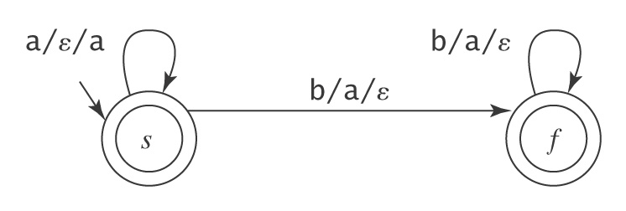
CFG to PDA
A PDA for A^{n}B^{n} = {a^{n}b^{n}: n ≥ 0}

Slide 67
Same Language: but with Stack Check
PDA :

Slide 68
Basic Idea:
Push the a’s
on the stack
2. Match the b’s on input
with a’s on stack
3. Match
found

Slide 69
Execution Example:
Time 0
Input
Stack
current
state

Slide 70
Time 1
Input
Stack

Slide 71
Time 2
Input
Stack

Slide 72
Time 3
Input
Stack

Slide 73
Time 4
Input
Stack

Slide 74
Time 5
Input
Stack

Slide 75
Time 6
Input
Stack

Slide 76
Time 7
Input
Stack

Slide 77
Time 8
Input
Stack
accept

Slide 78
Rejection Example:
Time 0
Input
Stack
current
state

Slide 79
Rejection Example:
Time 1
Input
Stack
current
state

Slide 80
Rejection Example:
Time 2
Input
Stack
current
state

Slide 81
Rejection Example:
Time 3
Input
Stack
current
state

Slide 82
Rejection Example:
Time 4
Input
Stack
current
state

Slide 83
Rejection Example:
Time 4
Input
Stack
reject
current
state

Slide 84
There is no accepting computation for
The string is rejected by the PDA

Slide 86
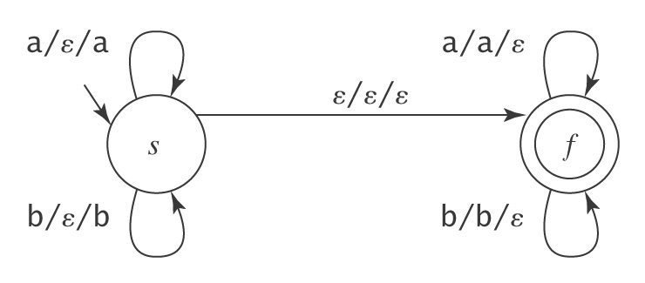
Another PDA example: Palindromes

Slide 87
Palindromes with stack checking
PDA :

Slide 88
Basic Idea:
Push v
on stack
3. Match on input
with v on stack
2. Guess
middle
of input
4. Match
found

Slide 89
Execution Example:
Time 0
Input
Stack

Slide 90
Time 1
Input
Stack

Slide 91
Time 2
Input
Stack

Slide 92
Time 3
Input
Guess the middle
of string
Stack

Slide 93
Time 4
Input
Stack

Slide 94
Time 5
Input
Stack

Slide 95
Time 6
Input
Stack
accept

Slide 96
Rejection Example:
Time 0
Input
Stack

Slide 97
Time 1
Input
Stack

Slide 98
Time 2
Input
Stack

Slide 99
Time 3
Input
Guess the middle
of string
Stack

Slide 100
Time 4
Input
Stack

Slide 101
Time 5
Input
There is no possible transition.
Input is not consumed
Stack

Slide 102
Another computation on same string:
Input
Time 0
Stack

Slide 103
Time 1
Input
Stack

Slide 104
Time 2
Input
Stack

Slide 105
Time 3
Input
Stack

Slide 106
Time 4
Input
Stack

Slide 107
Time 5
Input
No accept state
is reached
Stack

Slide 108
There is no computation
that accepts string

